Slide 1
PPG Signal Processing approach and proposal to Dr. Akar. By Scott Perryman
Objective - The objective of this presentation is to provide convincing support of the feasibility to extract the following features from a 1kHz sampled ppg signal: Blood Oxygenation, Heart Rate, Heart Rate Variability.
Goals:
Simulate a PPG signal from experimental data.
Develop and present thorough procedures that can be repeated in a lab setting.
Materials:
Matlab
PPG Data Set.

Slide 2
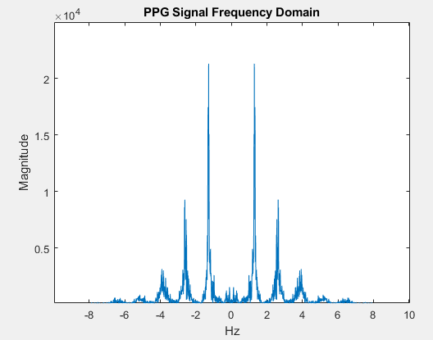
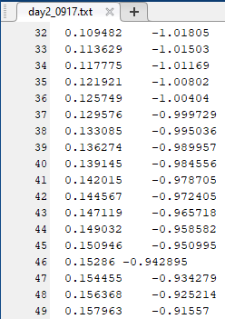
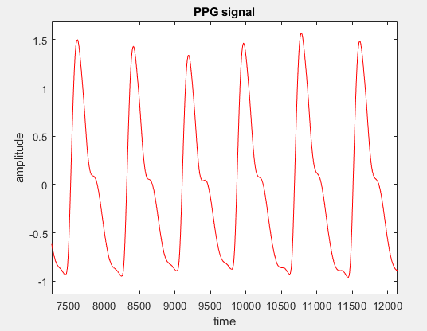
Data Set Properties
Signal Was Filtered during data acquisition so we assume arbitrarily low noise power.
1 kHz Sample Rate
Source: https://www.mathworks.com/matlabcentral/fileexchange/61315-ecg-ppg-signal-for-ptt-hrv-and-prv

Slide 3
Features
Biometrics
Peaks
DC-Component
AC-Component
Heart Rate
Heart Rate Variation
Blood Oxygenation

Slide 4
Peak Extraction
2 techniques Considered:
First Derivate of signal is equal to 0.
Logically, if both of temporally adjacent samples are less than, than there exists a peak. i.e. s(n-2)<s(n-1)>s(n)
*Technique 1 would only occur if our sample period approached 0. Impossible.
s(n) – s(n-1) = s’(n-1)
s(n-1)
*Technique 2 also implicitly checks for negative concavity. This is beneficial as you will see.
s(n-2)
C
s(n)
Delay
Delay
s(n-1)
0
s(n)
C
C
Delay

Slide 5
Peak Extraction
2 techniques Considered:
First Derivate of signal is equal to 0.
Logically, if both of temporally adjacent samples are less than, than there exists a peak. i.e. s(n-2)<s(n-1)>s(n)
*Technique 1 would only occur if our sample period approached 0. Impossible.
s(n) – s(n-1) = s’(n-1)
s(n-1)
*Technique 2 also implicitly checks for negative concavity. This is beneficial as you will see.
s(n-2)
C
s(n)
Delay
Delay
s(n-1)
0
s(n)
C
C
Delay

Slide 6
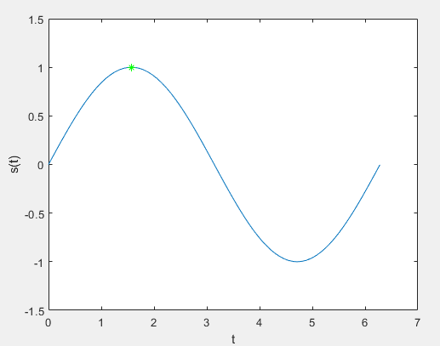
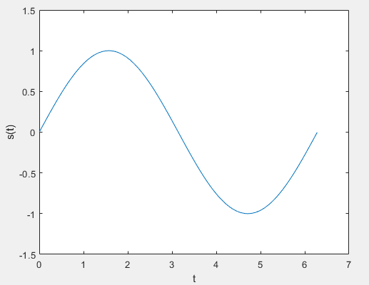
Peak Extraction
t = [0:.01:2*pi];
len = length(t);
s = sin(t);
figure
plot(t,s);
hold on
xlabel("t");
ylabel("s(t)");
ylim([-1.5 1.5])
Only Detects 1 peak
peakPos = [];
peakVal = [];
for i = 3:len
index = 1;
if( (s(i-1)>s(i-2)) && (s(i)<s(i-1)) )
peakPos(index) = i-1;
peakVal(index) = s(i-1);
end
end
peakPos = peakPos/100;
plot(peakPos, peakVal, '*g');

